Slide 1
April feedback and the Zilker Vision Plan
SOS and Rewild Zilker
Tanya Payne

Slide 2
Zilker Vision Plan Feedback opportunities
April 4, 5pm - Urban Transportation Commission (City Hall)
April 5, 6pm – Environmental Commission (ACC Highland Mall campus)
Later in April – Design Commission (TBD)
April 24, 5pm – Parks Board for final follow up action (City Hall)
May 11 - Mobility Committee of City Council

Slide 3
Environmental Commission
Remove all parking garages, particularly the underground garage, saving over $60 M
Recommend the City of Austin (not the consultants) provide an accurate item by item calculation of:
Existing impervious cover
Proposed impervious cover
Propose impervious cover with out the proposed parking
Request that PARD and City of Austin Watershed Department provide a written briefing to you regarding the feasibility and related costs of rewilding in Zilker vs ecological uplift
Ask the Office of Sustainability to calculate the overall climate and equity impact of each element proposed in the plan with regard to alignment with the City’s Climate and Equity Plan
Vote on the same recommendation approved by the Parks Board to remove the “umbrella non-profit” from the plan and instead fully fund PARD to manage all aspects of Zilker
What you love about Zilker Park

Slide 5
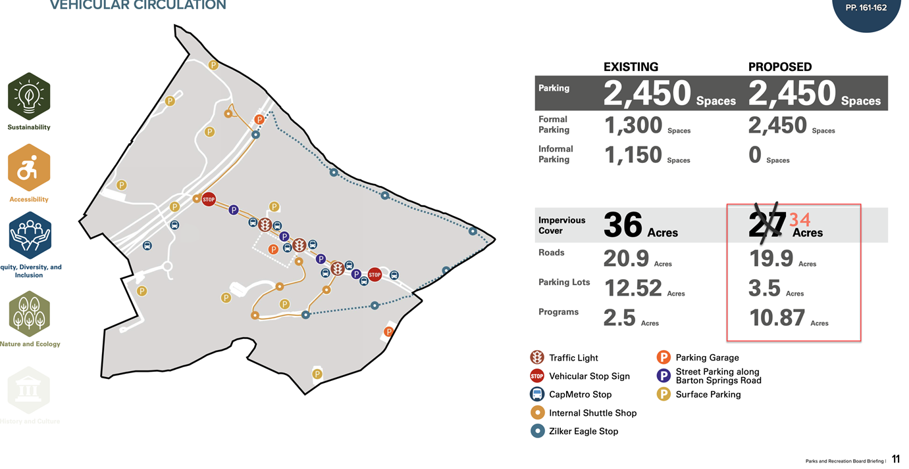
Impervious cover calculations are incorrect
Notes:
One aspect of the plan that the Design Team repeatedly brags on is the idea that they will recapture 9 acres of natural land by adding the parking garages. However, we noticed that that isn’t even correct. They have an addition error and the proposed plan actually has 34.27 acres of impervious cover, leaving the plan with less than 2 acres of impervious cover – that’s about $30 million dollars and acre.
Take a look at how that happened. They went from 2.5 acres of programs to 10.87

Slide 6
Please go!
Sign up in person to speak or email ahead (I did!)
Item 5
To register to speak remotely, call or email Elizabeth Funk, Watershed Protection Department, at (512) 568-2244, Elizabeth.Funk@austintexas.gov, no later than noon, the day before the meeting.
https://services.austintexas.gov/edims/document.cfm?id=405334&eType=EmailBlastContent&eId=f9e133a4-2fc0-422c-82e7-83a11e32dab3
If you can’t attend, please email

Slide 7
Permitting And Development Center, Events Center, Room 1405 6310 Wilhelmina Delco Drive Austin, Texas 78752

Slide 8
Environmental Commission emails
bc-Pam.Thompson@austintexas.gov bc-haris.qureshi@austintexas.gov BC-Perry.Bedford@austintexas.gov BC-Richard.Brimer@austintexas.gov BC-Jennifer.Bristol@austintexas.gov BC-Rachel.Scott@austintexas.gov bc-colin.nickells@austintexas.gov bc-melinda.schiera@austintexas.gov BC-Kevin.Ramberg@austintexas.gov BC-David.Sullivan@austintexas.gov
BC-Hann.Cofer@austintexas.gov

Slide 9
Urban and transportation Commission
No Barton Springs Rd diet without a traffic study
Align transportation projects in Austin:
Barton Springs Rd diet from Zilker Vision Plan
Barton Springs bridge project
Project Connect
Safe streets, etc.
No parking garages
Instead use green parking solutions
Utilize close-by parking garages
Provide a free park shuttle bus from all across Austin to access Zilker
Why you love Zilker Park

Slide 10
Please email
If you can go, please do
But prioritize the Environmental Commission!
City Hall
Registration no later than noon the day before the meeting is required for remote participation. To register please call or email the staff liaison in advance at (512) 978-1568 or Christopher.Parks@austintexas.gov by noon on Tuesday April 4th , with the following information: name, item number(s) to speak on, telephone number, and email address.
Item 2
https://services.austintexas.gov/edims/document.cfm?id=405135

Slide 11
Urban Transportation Commission emails
bc-Cynthia.Weatherby@austintexas.gov bc-cecilla.ramos@austintexas.gov BC-Susan.Somers@austintexas.gov BC-Ruven.Brooks@austintexas.gov BC-Diana.Wheeler@austintexas.gov BC-Athena.Leyton@austintexas.gov bc-daniel.kavelman@austintexas.gov bc-edward.smith@austintexas.gov bc-spencer.schumacher@austintexas.gov bc-curtis.rogers@austintexas.gov

